Slide 1
Sentiment Analysis
Ai Infrastructure & Arch.
Ciao Gasparine
By- Aman Joshi & Akshit Bajaria

Slide 2
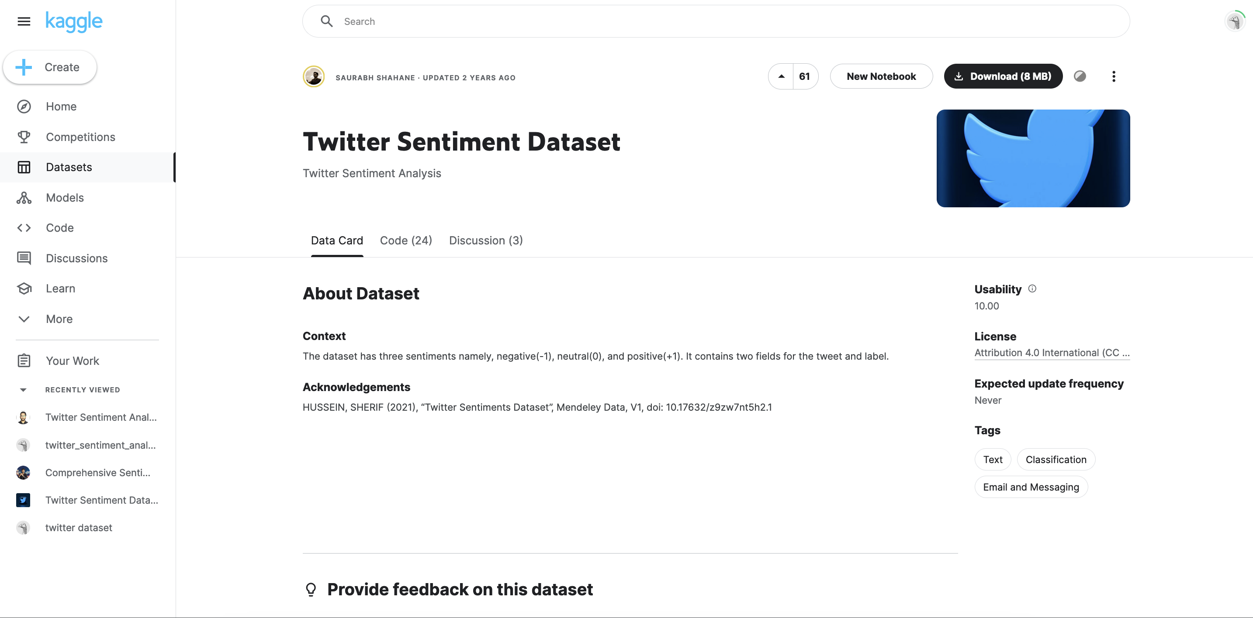
Twitter Sentiment Analysis

Slide 3
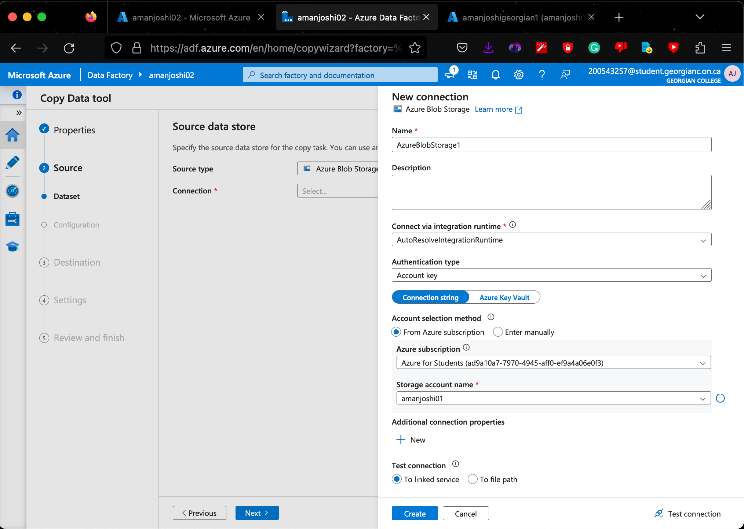
Used Azure Data factory to push the Data from Azure Blob Storage to Azure SQL Storage

Slide 4
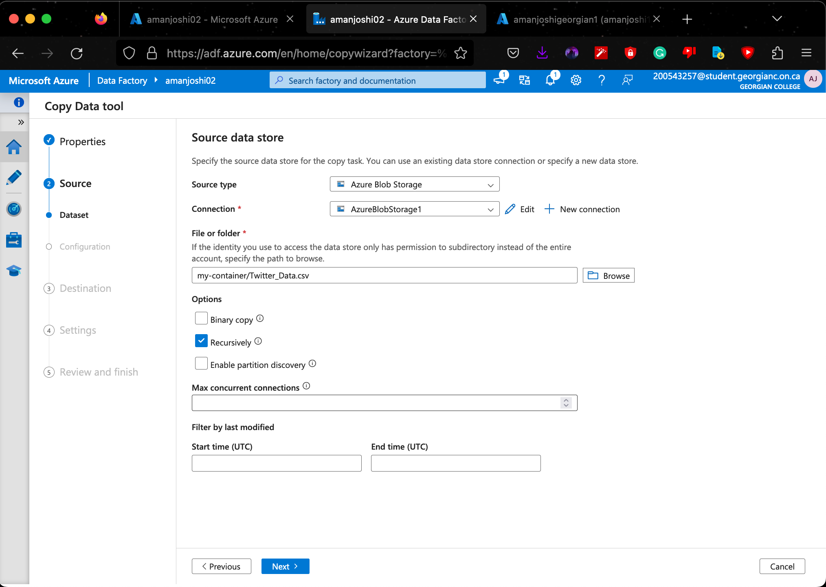
Adding CSV to blob storage

Slide 5
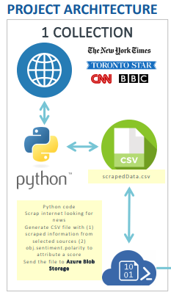
Architecture 1 : Data Collection Complete

Slide 6
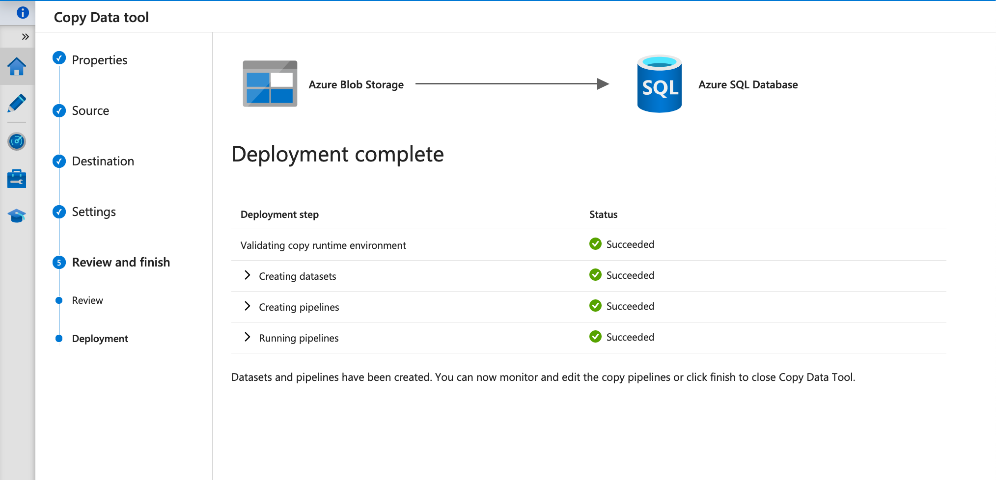
Deployed the CSV successfully from Azure Blob storage to Azure SQL Database

Slide 7
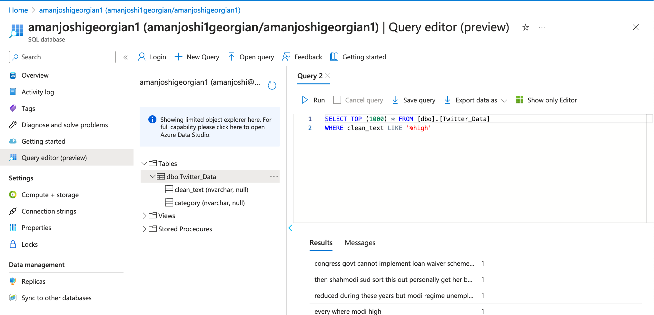
Tried running the queries on Azure ML Portal

Slide 8
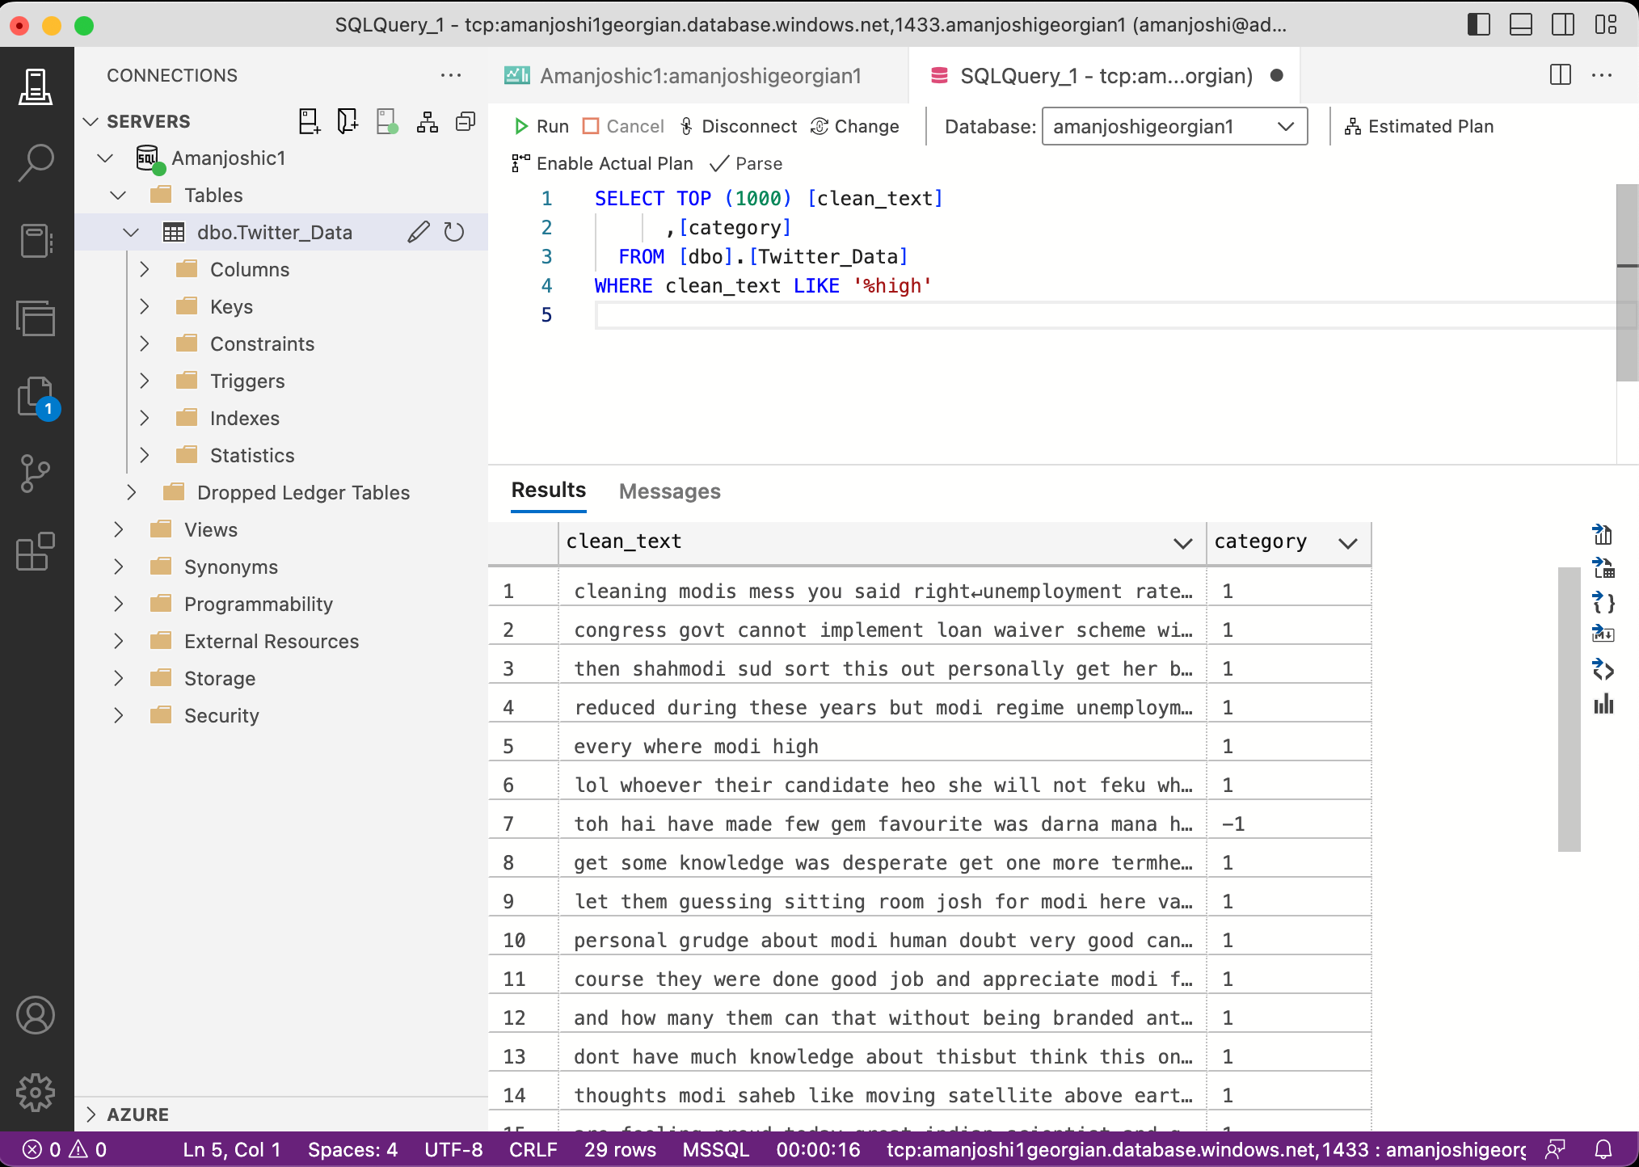
Even ran the blob from Azure Data Studio
(Successfully completed)

Slide 9
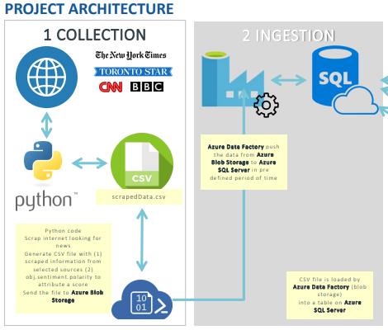
Architecture 2 : Data Ingestion Complete

Slide 10
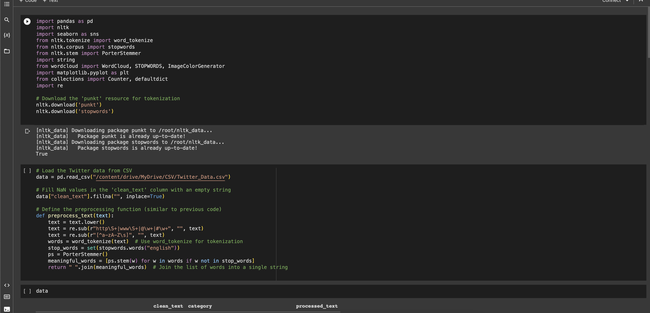
Here are the snapshot of our .ipynb file

Slide 11
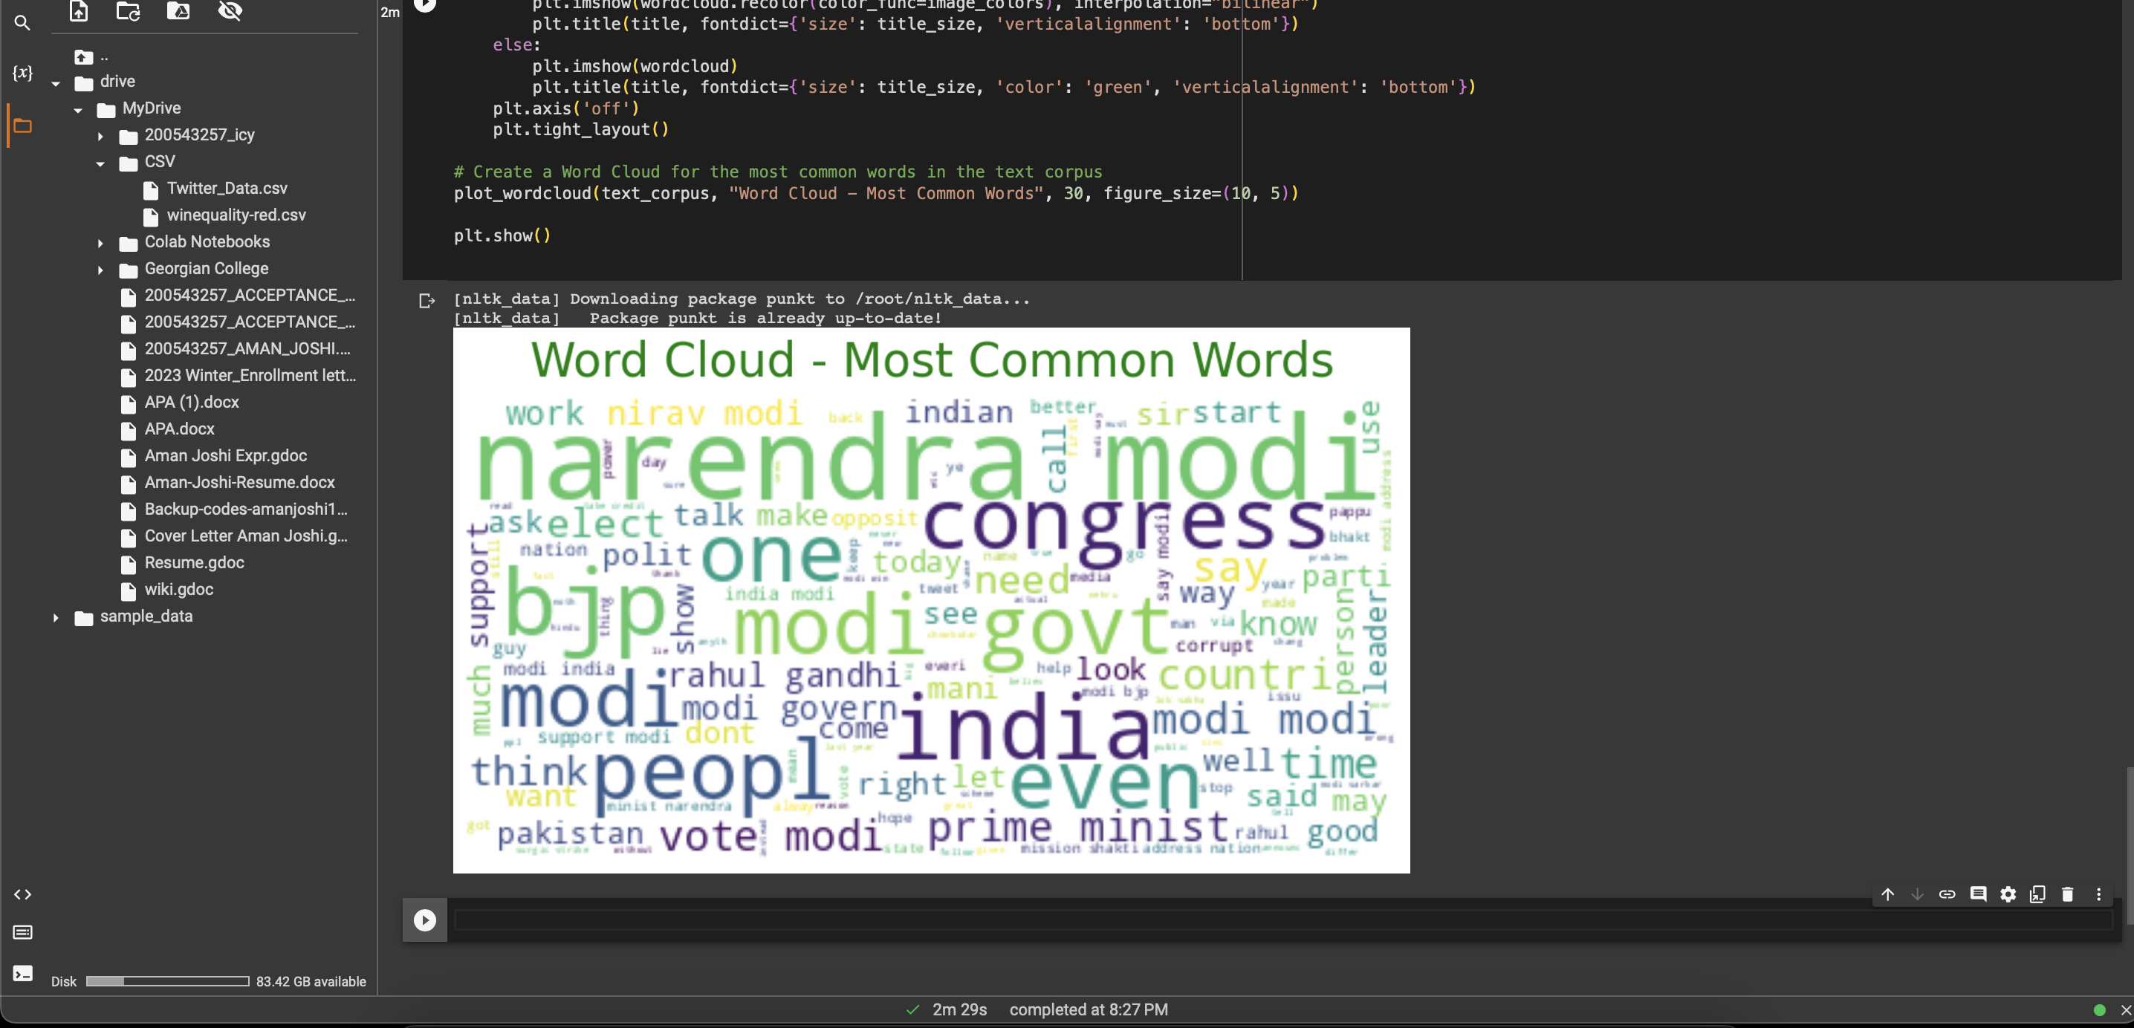
Here are most common words from the tweets from the CSV file

Slide 12
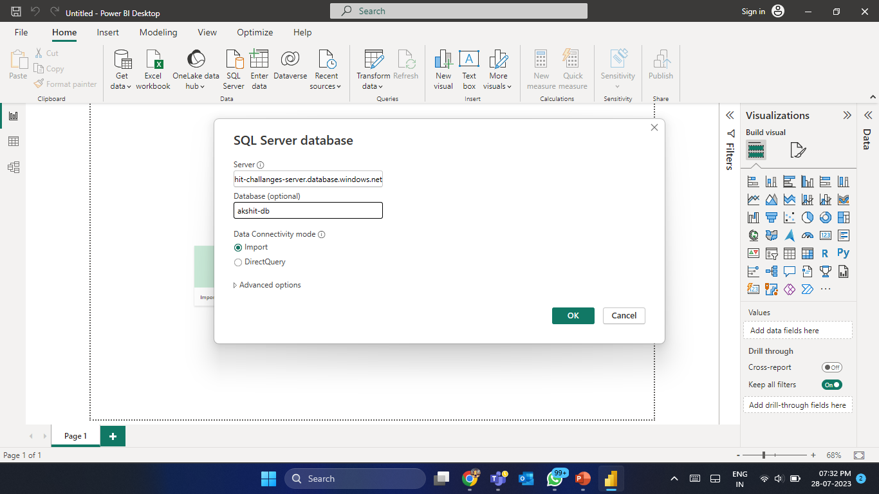

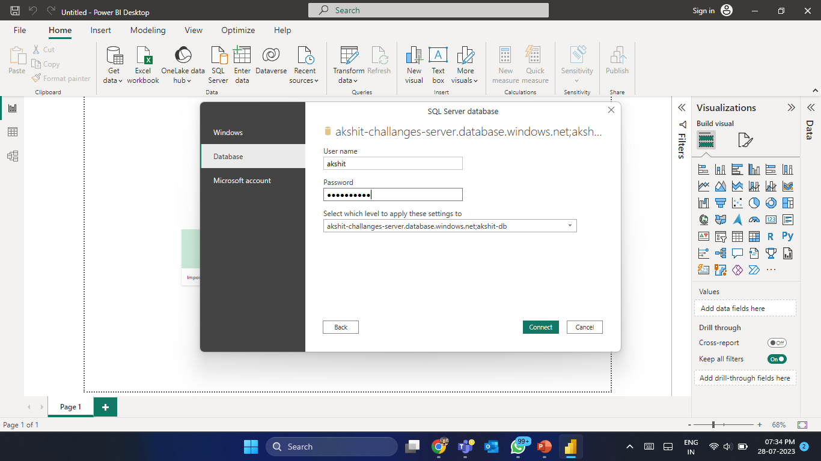
Power BI Data Access
through SQL server database

Slide 13
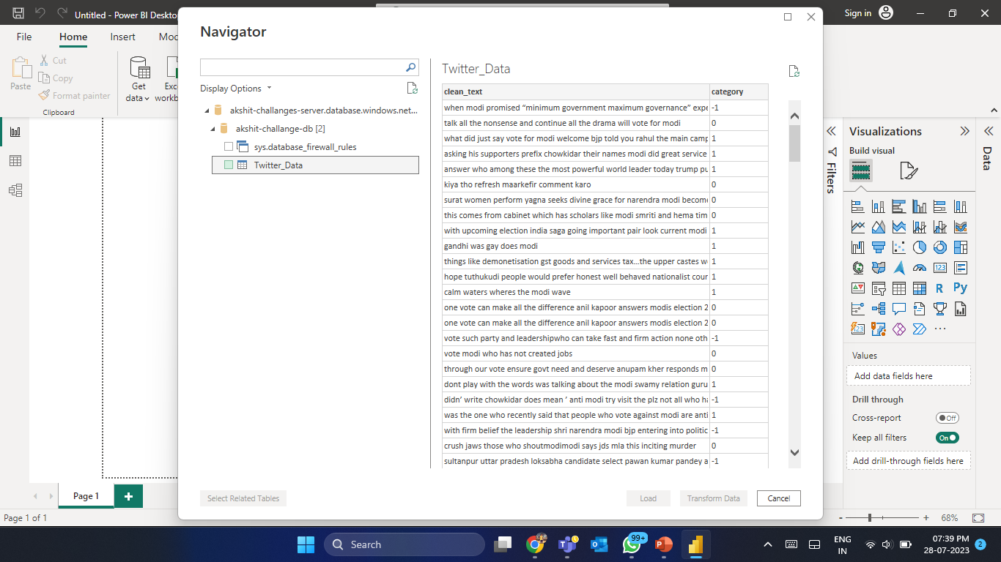
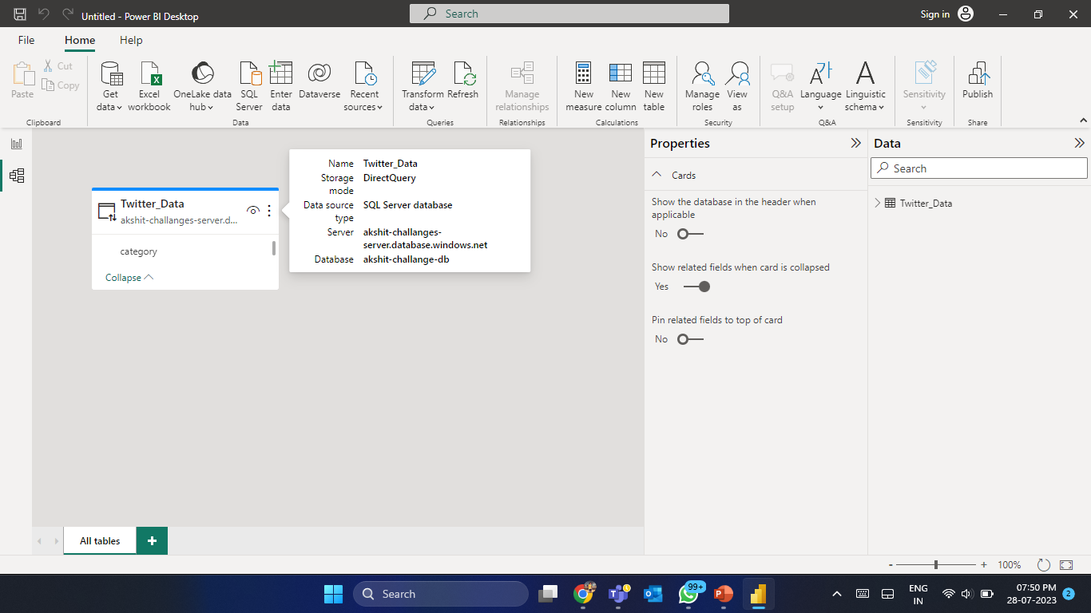
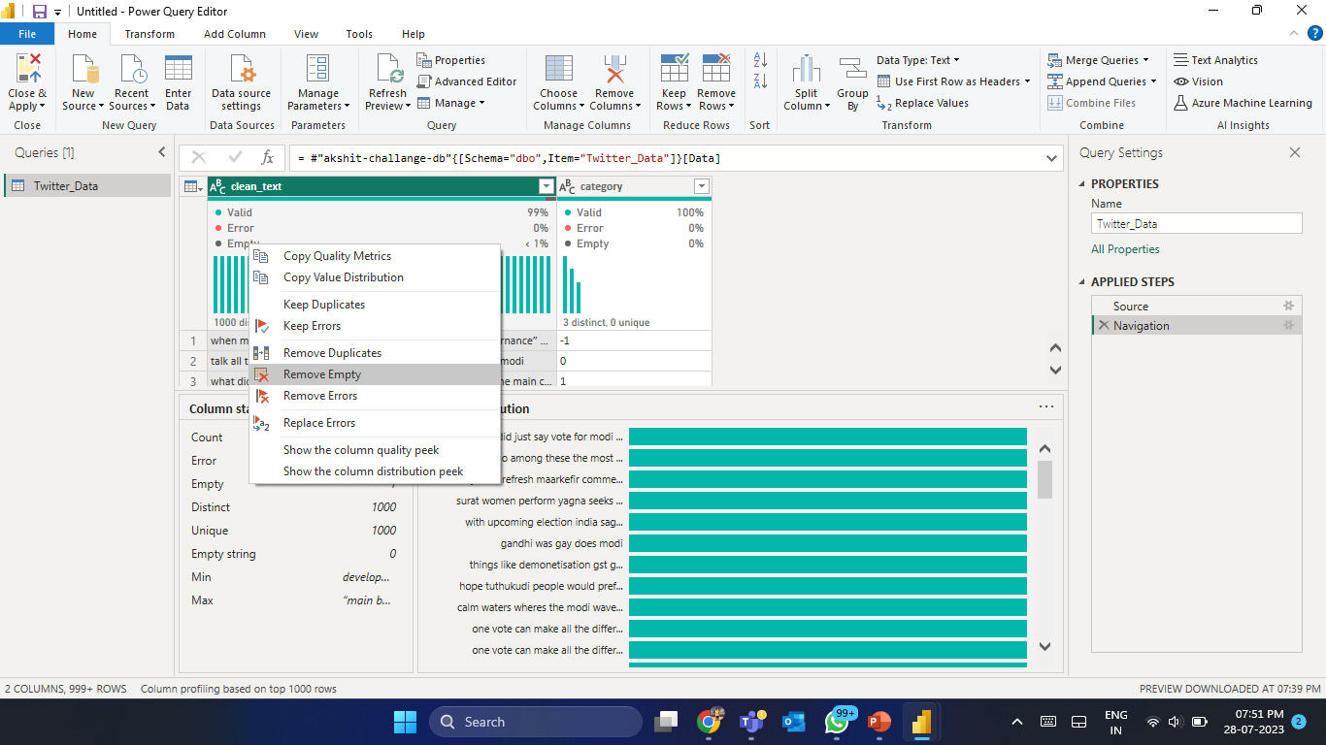
Power BI Visualizations

Slide 14
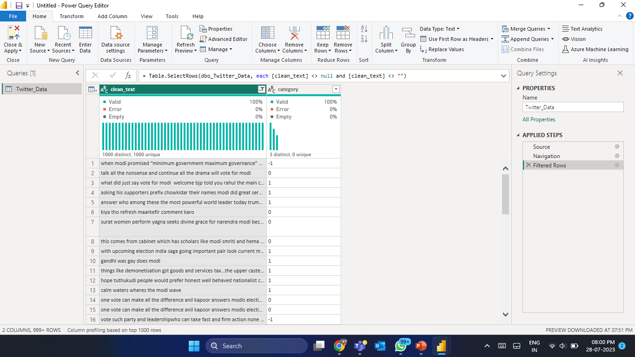
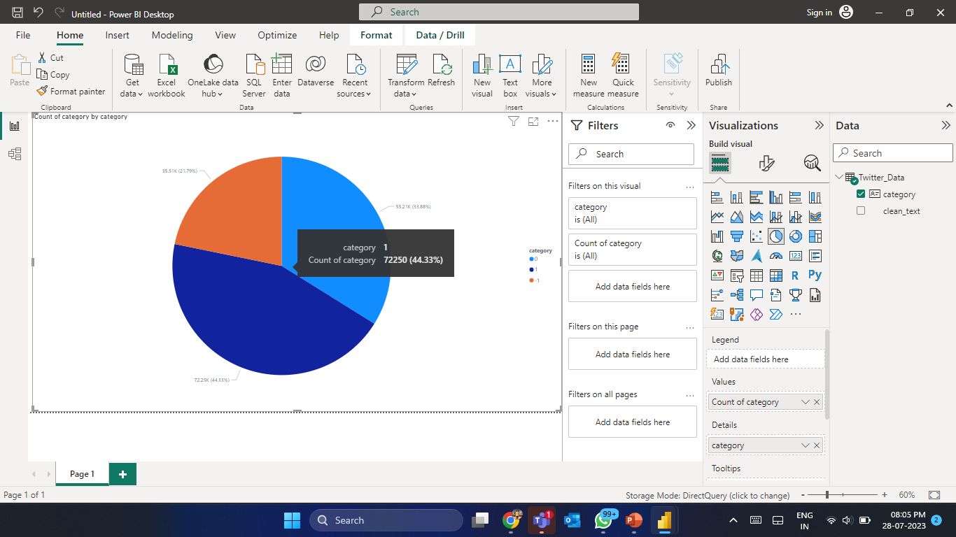
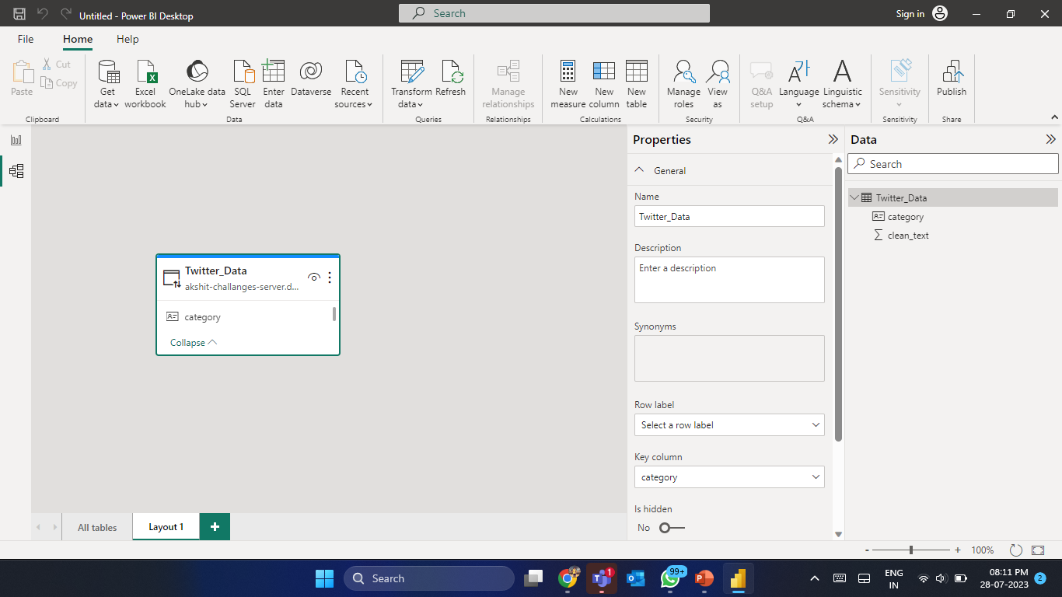
Power BI Visualizations

Slide 15
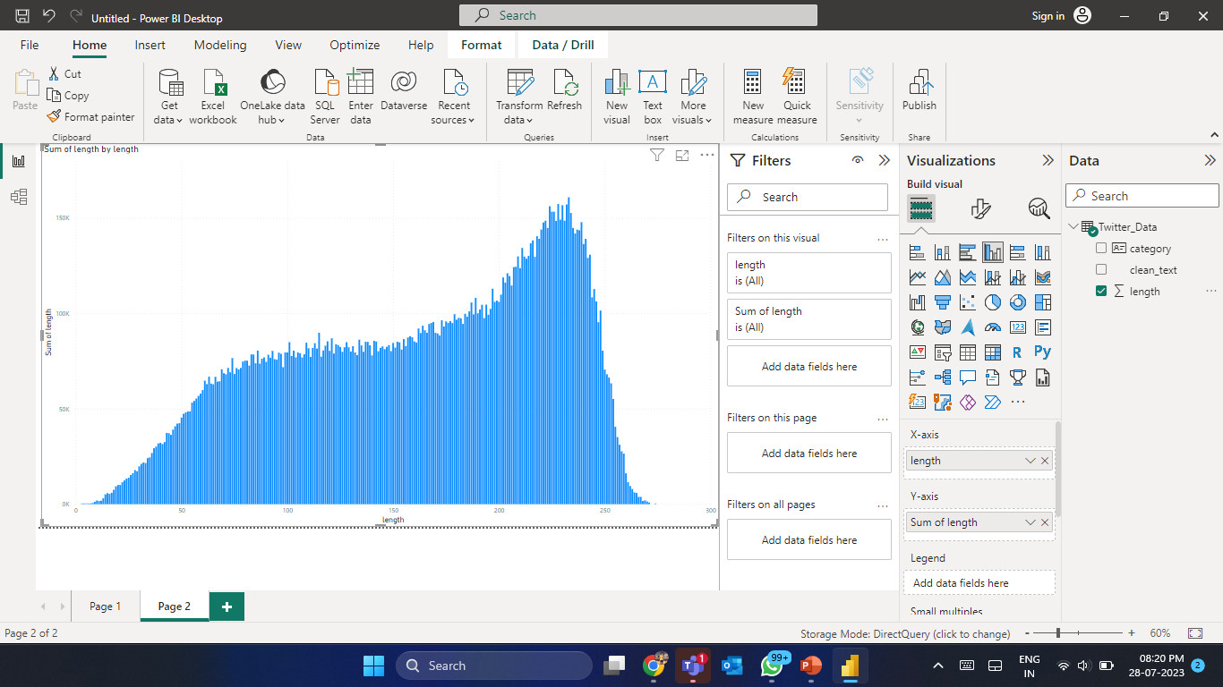
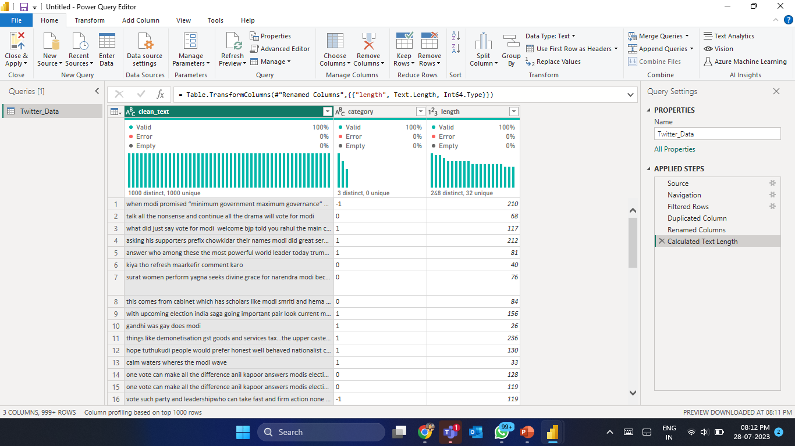
Power BI Visualizations

Slide 16
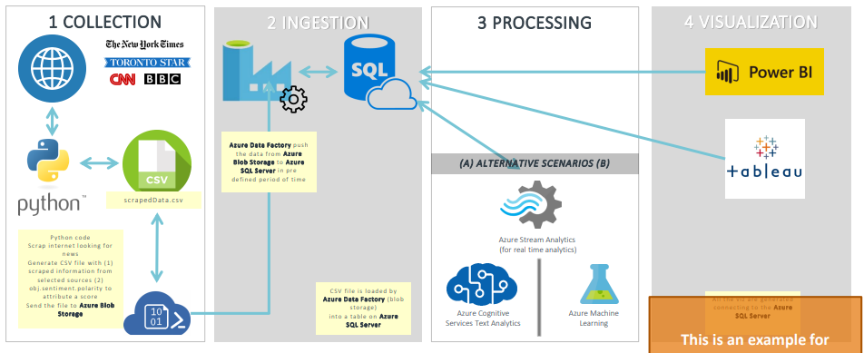
Architecture 3 & 4 : Data Processing & Visulization Complete

Slide 17
Github Link
https://github.com/BAkshit22/Assignment-4---Sentimental-Analysis

Slide 18
“Thank You.”
– Aman Joshi & Akshit Bajaria

